Slide 1
Community Cup Poster Design
Presentation
By
Nathan Hallam

Slide 2
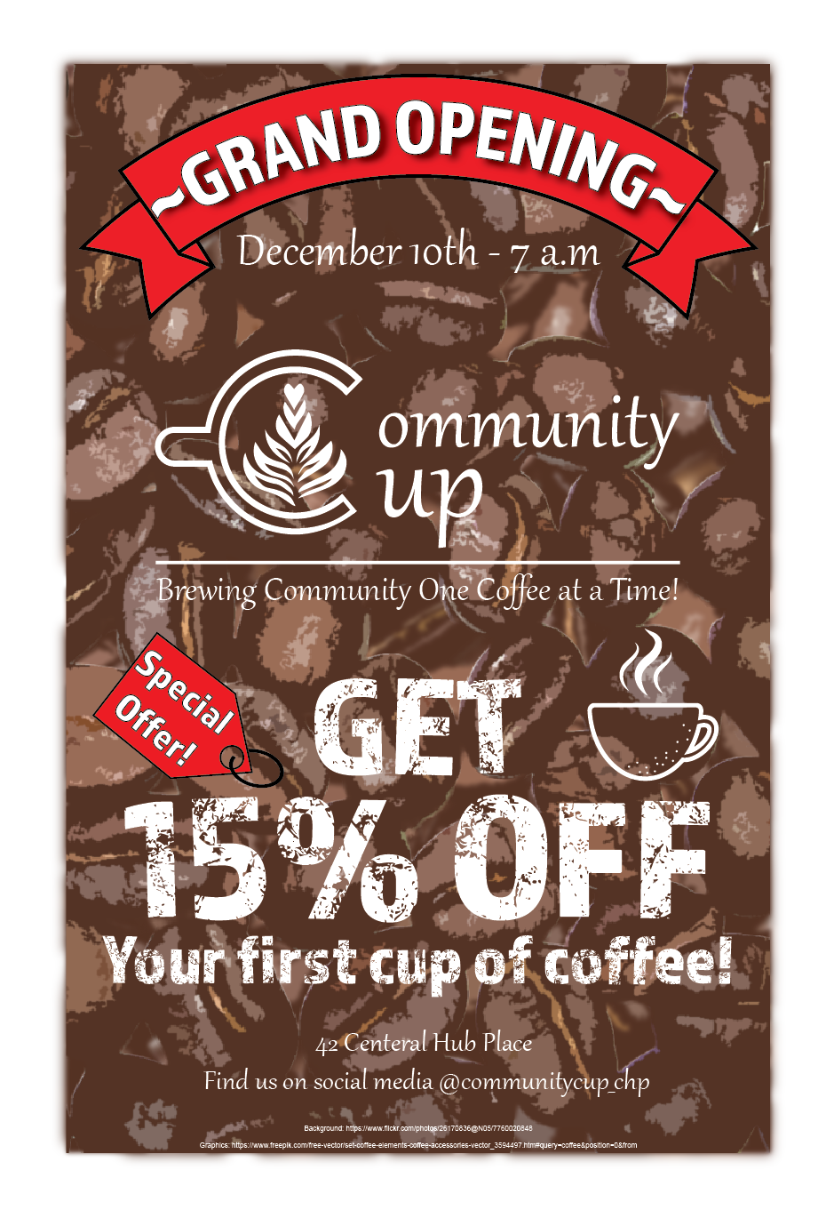
Organization of Content
1.
3.
2.
4.
Notes:
For this poster design I decided to stick to a set alignment for each type to increase the readability and overall flow of the poser. Each element is ordered in a way that is relatively cohesive if read in a paragraph format. Emphasis is placed on elements in a separate order based on scale and color to further accentuate their importance.
In this case the grand opening and special offer tags are colored red to signify the need for urgency, while the call-to-action discount is the largest element, catching the eye of the reader due to it limited time availability.
For an increase in readability all elements on the poster have been placed in a vertically aligned format, defining a rough hierarchy based on basic understanding of reading.
Four sections are defined by a small space and proximity of elements, creating a theoretical dividing line.

Slide 3
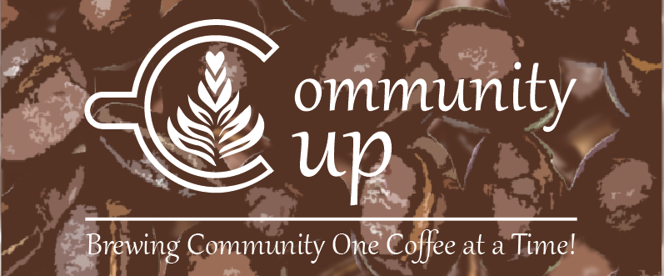
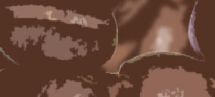
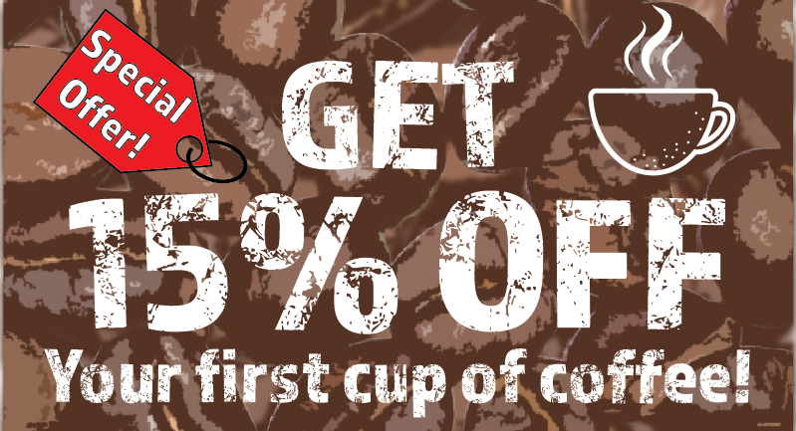
Choice of Design and Visual Elements
1.
2.
3.
Notes:
Learning from my peers I decided to choose an image for a background over solid colors. An image of coffee beans was chosen to add depth to the poster as well as allude to the coffee shop as a whole without much context. The coffee cup graphic in image 2 was shaped into the letter ‘C’ and placed into the company name to make an impromptu logo that is easy to read but still unique, coupled with the given body text makes a good logo and slogan combination. Additional graphics were placed next to the discount to fill white space as well as draw attention to the discount. The shape of the discount tag can be taken as an arrow pointing to the discount instead of the designed tag image. Negative space is left around each grouping of elements and the edges of the poster to allow the viewer to notice the coffee bean background without the unnecessary noise, alongside with creating the hierarchy of the poster.
When designing the poster I wanted to have a strong emphasis on the coffee from Community Cup. This influenced the appeal of the poster with its coffee bean background. Three separate layers of the same image were cropped to different sizes alongside an increasing blur effect gives of the feeling of looking into a large pile of beans. A small amount of space is kept around all visual elements to allow the viewer to see the background without as much noise or interference from other elements (displayed best in image 2).
In regards to the company logo, a line is placed between the name “Community Cup” and the body “Brewing Community One Cup at a Time!” This helps to create distinction between the name of the brand and the slogan defining it.
Additional shapes and graphics were positioned to fill in whitespace around the call to action, and to help with giving a rough impression at a glance as to what the call to action is about.

Slide 4
Delivery of Message
1.1.
1.2.
2.1.
2.2.
4.
3.
Notes:
From the design brief, the company is opening a new shop that they want to feel homely and community oriented, where people of all ages can gather and chat over coffee or other beverages. To embody this idea first was the coffee aspect. The background is of coffee beans to immediately convey the essence of coffee to the viewer at a glance, while additional coffee graphics are placed to cement the image further. With the opening of a new shop the company is giving a discount on the first cup of coffee for a limited time, this is conveyed with large bold text and red coloring. For the feeling of community there is the coffee cup graphic with the heart shaped plant, the elegant look of the Gabriola font, and the artistic look of the coffee bean background making the poster look not only one of a kind but less stuck up or refined.
Coffee graphics allude to coffee shop. Heart shape plant inside logo coffee cup (image 1.1) signifies community.
Color red signifies the urgency and limited nature of the discount.
Base font “Gabriola” is neat, clean, and slightly stylized, giving a sense of unity.
Almaq font used in sale looks as if it is dissolving, adding to the urgency. Discount type is scaled, taking up nearly ⅓ of the poster as a means to catch the attention of the viewer.

Slide 5
Readability
1.
2.
3.
Notes:
Given the dark background of the poster all text elements are in white, giving it the necessary contrast for improved legibility. All text is 36pts or larger with the most important information such as the discount, company name, and grand opening being the larger in scale. All text elements are vertically aligned with a moderate amount of space between elements in close proximity as well as the edges of the poster to allow for subconscious differentiation between each text element. Colors are different enough to be readable by people with most types of color blindness.

Slide 6
Typography
1.1.
2.1.
1.2.
2.2.
Notes:
The call to action requires some amount of urgency or attention drawing behaviour. Because of this a large and bold font was selected. In contrast a thinner and more elegant font was chosen as the base font
Gabriola is used as the main font for its readability and slightly stylized, elegant look (Alib-Ms.). Readable and defined matching the aesthetic of the coffee shop.
Almaq is used for the call-to-action elements for its large bold type. The font comes in two types ‘refined’ (2.1) and ‘rough’ (2.2). Reminiscent of the broad strokes made in coffee art using milk or cream.

Slide 7
Choice of Colors
2.1.
2.2.
1.
3.
Notes:
To keep the colors inline with the image of the coffee shop, multiple shades of brown are used in the background adding depth. White text is used for its contrast with the brown background while red is used to emphasis the call to action.
Brown coffee bean background used for its direct correlation with the company image.
Red graphics used for its psychology to stimulate and excite (Cherry (2023b)).
White text used for its contrast on the brown background as well as its cleanliness and freshness (Cherry (2023a)).

Slide 8
Works Cited
Alib-Ms. (2022, March 30). Gabriola font family - Typography. Microsoft Learn.
https://learn.microsoft.com/en-us/typography/font-list/gabriola
Cherry, K. (2023a). The Meaning of the Color White. Verywell Mind.
https://www.verywellmind.com/color-psychology-white-2795822
Cherry, K. (2023b). Red Color Psychology. Verywell Mind.
https://www.verywellmind.com/the-color-psychology-of-red-2795821

